Slide 1
STORY GENERATOR
Our first step to autonomous world

Slide 2
Acknowledgement
Dear Dhanpratap Sir, Special thanks to you for teaching us and making us understand the basic concept of python.
It was really a great journey with my class platform where we was just aware with your voice but was enough to learn the things.
Well special thanks to our group members too that we have collaborated in such a nice way and finally done with this project.
It was a great journey.
Group members
Aman India
Aniket ponia
Divyansh
Project submitted to:
Respected Dhanpratap Sir

Slide 3
ABOUT PROJECT STORY GENTRATOR
Project Story generator is just not a project, it is more than coding and other stuff like making out.
In this project we had gone with meeting for designing it, Using best inbuild function to implement and a lot of research.
The time taken in this project is almost 15 hours of week and a lot of dedicated attention.

Slide 4
Functions And Library used in making Story Generator project
Tkinter Library
Tkk function
Grid Method
Random Library
Choice

Slide 5
CODING STUFF

Slide 6
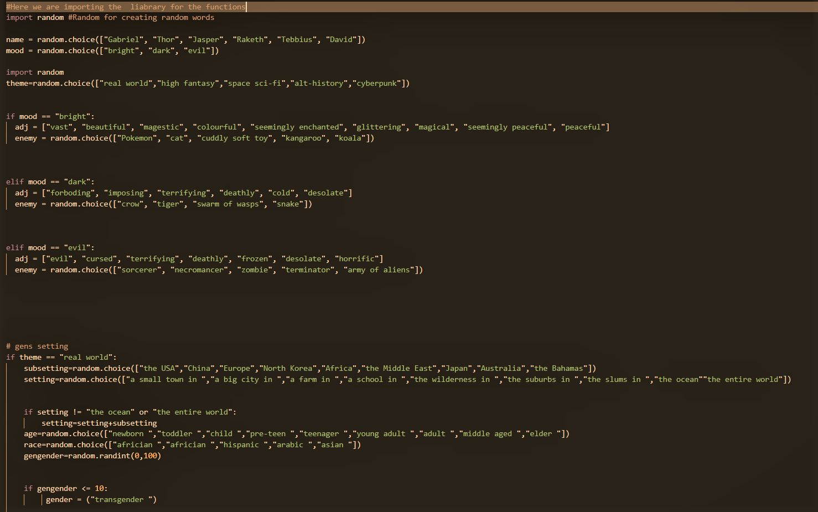

Slide 7
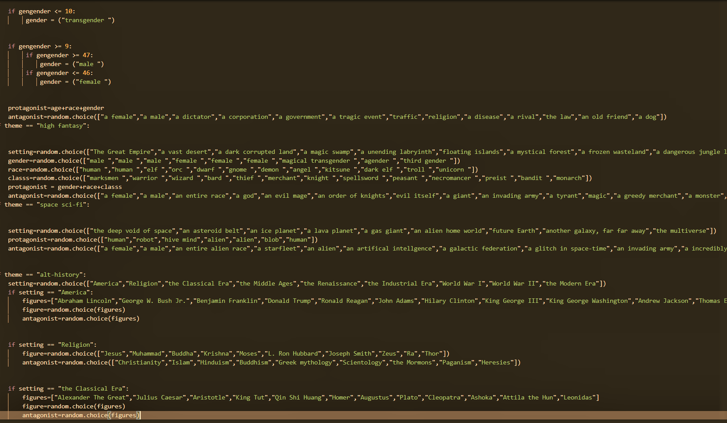

Slide 8
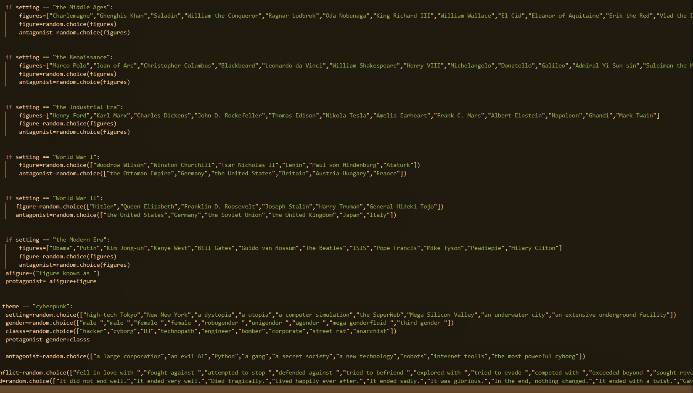

Slide 9
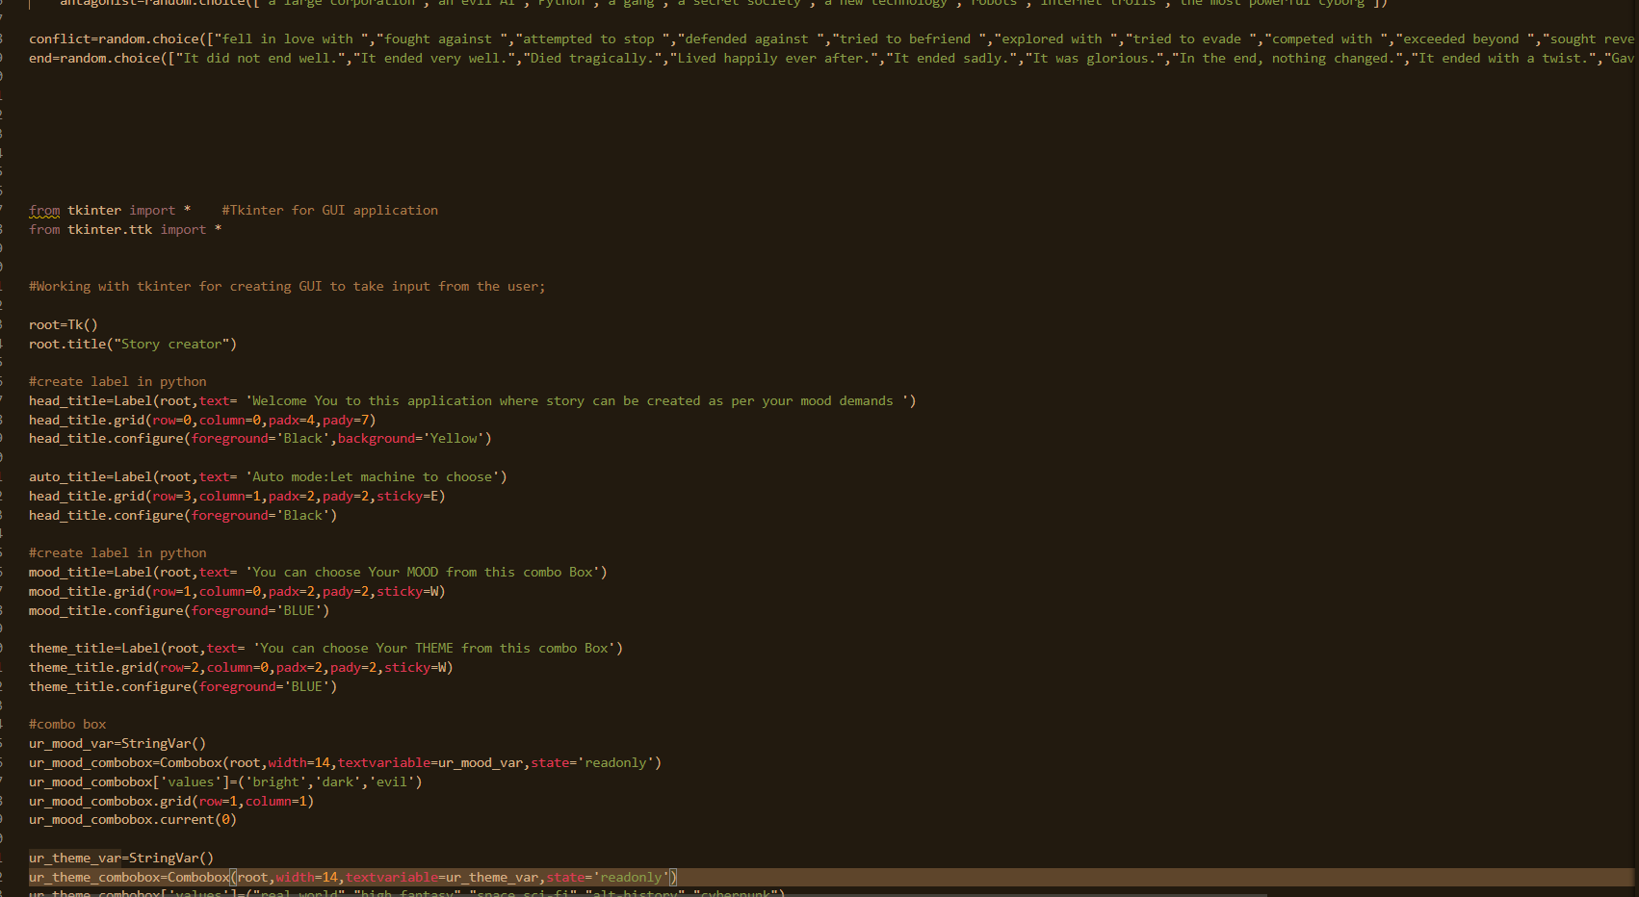

Slide 10
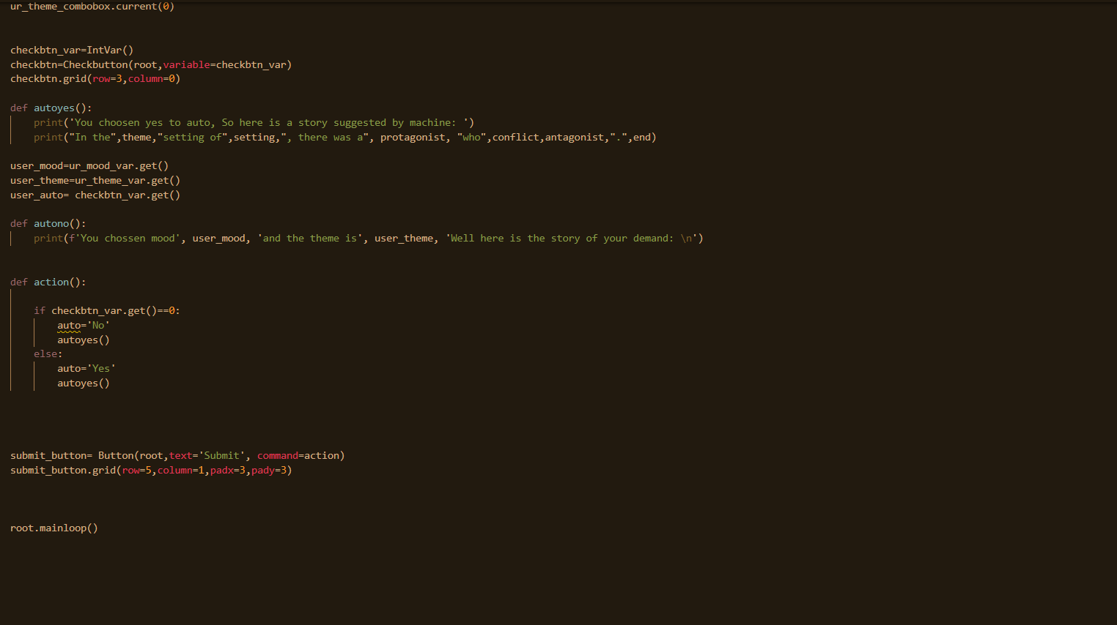

Slide 11
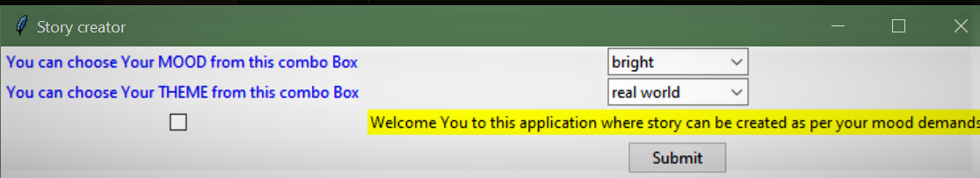
GUI
(Graphical user interface of our program)

Slide 12

OUTPUT OF PROJECT

Slide 13
CONCLUSION: Conclusion is a beautiful story generated by the code. The code will work according to your mood and learning were coding

Slide 14
REFERENCES: Stack overflow Geeksforgeeks Tkinter

Slide 15
Thank You

